Slide 1
Nature’s poet

Slide 2
“What are human beings, that you make so much of them, that you set your mind on them, visit them every morning, test them every moment?”
Where in the Bible do you find this passage?
What other biblical passage does it make you think about?

Slide 3
³ When I look at your heavens, the work of your fingers, the moon and the stars that you have established; ⁴ what are human beings that you are mindful of them, mortals that you care for them? ⁵ Yet you have made them a little lower than God, and crowned them with glory and honour. ⁶ You have given them dominion over the works of your hands; you have put all things under their feet, ⁷ all sheep and oxen, and also the beasts of the field, ⁸ the birds of the air, and the fish of the sea, whatever passes along the paths of the seas. (Psalm 8)

Slide 4
¹⁷ What are human beings, that you make so much of them, that you set your mind on them, ¹⁸ visit them every morning, test them every moment? ¹⁹ Will you not look away from me for a while, let me alone until I swallow my spittle? ²⁰ If I sin, what do I do to you, you watcher of humanity? Why have you made me your target? Why have I become a burden to you? (Job 7.17-20)

Slide 5
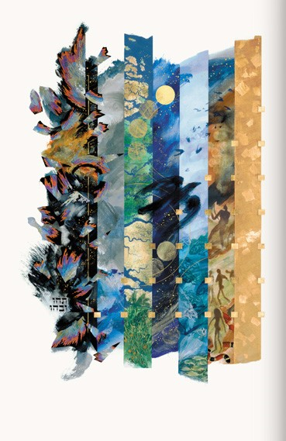

Slide 6
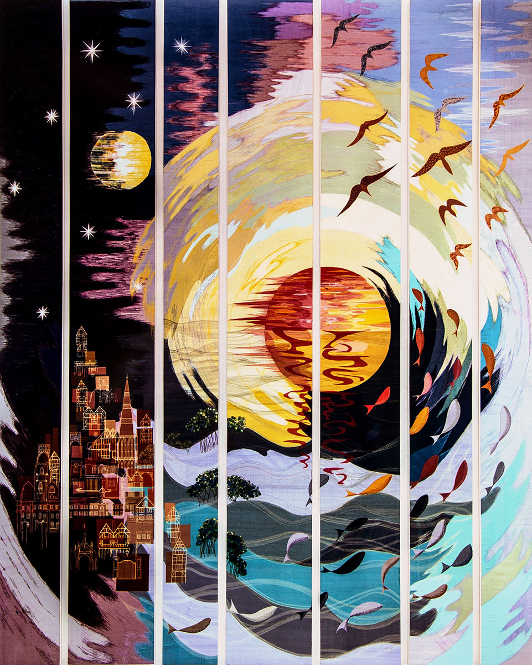

Slide 7
26 Then God said, ‘Let us make humankind in our image, according to our likeness; and let them have dominion over the fish of the sea, and over the birds of the air, and over the cattle, and over all the wild animals of the earth, and over every creeping thing that creeps upon the earth.’ ²⁷ So God created humankind in his image, in the image of God he created them; male and female he created them. ²⁸God blessed them, and God said to them, ‘Be fruitful and multiply, and fill the earth and subdue it; and have dominion over the fish of the sea and over the birds of the air and over every living thing that moves upon the earth.’ ²⁹God said, ‘See, I have given you every plant yielding seed that is upon the face of all the earth, and every tree with seed in its fruit; you shall have them for food. (Genesis 1.26-29)

Slide 8
The dignity of man is the dignity of the image of God (Pius XII Christmas Broadcast of 1944)
Our concern for human rights is based on our conviction that God wills a society in which all can exercise full human rights. All human beings are created in the image of God, equal and infinitely precious in God’s sight and ours. Jesus Christ has bound us to one another by his life, death and resurrection, so that what concerns one concerns us all. (World Council of Churches, Fifth Assembly, Nairobi, 1975)
All theological statements on human rights derive from the Christian anthropology of the human person made in the image of God. (World Alliance of Reformed Churches, approx. 1975)

Slide 9
The ‘Stewardship’ Model
That human beings are called to be stewards of creation tends to be the default position within ordinary Christian groups. (Christopher Southgate)
We all share and depend on the same world, with its finite and often non-renewable resources. Christians believe that this world belongs to God by creation, redemption and sustenance, and that he has entrusted it to humankind, made in his image and responsible to him; we are in the position of stewards, tenants, curators, trustees or guardians, whether or not we acknowledge this responsibility. Stewardship implies caring management rather than selfish exploitation; it involves a concern for both present and future as well as self, and a recognition that the world we manage has an interest in its own survival and well being apart from its value to us.
(Church of England, Board of Social Responsibility Report, 1991)

Slide 10
James Lovelock: The idea of human stewardship of creation is ‘sheer hubris’
Lynn White: ‘Especially in its western form, Christianity is the most anthropocentric religion the world has seen’. (The Historic roots of our Ecologic crisis, 1967)

Slide 11
GOD
HUMANITY
NATURE/CREATION

Slide 12
In the day that the Lord God made the earth and the heavens, ⁵when no plant of the field was yet in the earth and no herb of the field had yet sprung up—for the Lord God had not caused it to rain upon the earth, and there was no one (adam) to till (lit ‘worship’ , ‘serve’ )the ground (adamah); ⁶but a stream would rise from the earth, and water the whole face of the ground (adamah)— ⁷then the Lord God formed man (adam) from the dust of the ground (adamah), and breathed into his nostrils the breath of life; and the man (adam) became a living being. (Genesis 2.4b-7)

Slide 13
Genesis 1 and 2 are not the only parts of the Old Testament that help us reflect on creation and nature. The theologian William Brown speaks of the ‘Seven Pillars of Creation’ which he describes as:
Genesis 1.1-2.3
Genesis 2.4b-3.24
Job 38 – 41
Psalm 104
Proverbs 8.22-31
Ecclesiastes 1.2-11; 12.1-7
Isaiah 40 – 55 (excerpts)
Brown suggests that each of these is ‘worthy of reflection but incomplete in itself.’

Slide 14
Psalm 104: ‘The pearl of the psalter’
"In Psalm 104, the world that God creates and recreates is not just ordered, but rhythmic, each created thing a note that contributes to the Spirit's song.“ (Elizabeth Webb)
"Psalm 104 presents a glorious picture of God as creator and a sweeping view of the world God made.“
Psalm 104 presents creation ‘as the glory robe of God’.
In small groups please read Psalm 104 together (perhaps reading ‘antiphonally’) and then explore together some of the following questions:

Slide 15
Psalm 104: Some questions for you to discuss
Notice how the psalm begins and ends with very similar phrases. What message does this convey to you?
What similarities do you pick up between the description of the creation of the world in this psalm and the description in the first half of Genesis 1?
Take a particular look at the mentions of human beings and the place which is given to them in the Psalm. What does this say about the psalmist’s view of the relationship between humanity, creation and God?
It has been noted how the psalm celebrates the ‘wildness’ of creation, the wilderness and the wild creatures. Do you spot this and what do you think this might signify?
Do you think that from the perspective of the psalmist creation is a past event or is still continuing?
What do you make of the reference to Leviathan (verse 26)?
What do you understand by the word ‘glory’ (verse 31)?
Does the comment about ‘sinners’ (verse 35) jar with the rest of the Psalm?

Slide 16
Providential care is God’s passion: the psalmist exhorts God to ‘rejoice’ in creation, to find joy in creation’s abundance, diversity and capacity for accommodation
Creation is sustained by God’s unabashed joy.
References to ‘play’ are not common in the Bible – but there is an important example of this here (verse 26)
Psalm 104 is an exercise in joy, one that the psalmist encourages even God to share in… As plants are shared, wine is distributed and all are filled with ‘good things’ (v.28), so joy is passed from creator to creature, and from creature to creator.
Note the comment that God made all creation ‘in’ (or ‘by’) wisdom. (v.24)

Slide 17
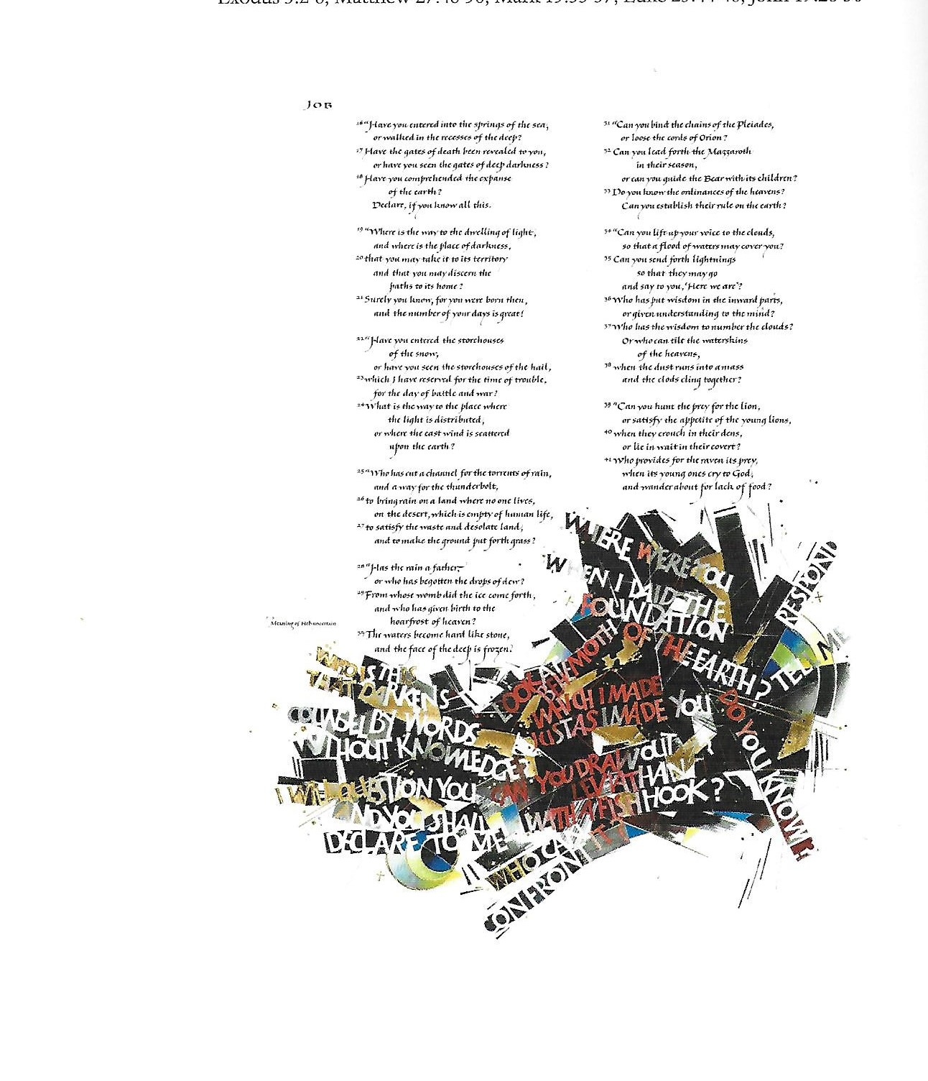
Who shut in the sea with doors when it burst out from the womb? When I made the clouds its garment and thick darkness for its swaddling band?
Where were you when I laid the foundation of the earth?
Were you there when the morning stars sang together, and all the heavenly beings shouted for joy?
Have you entered into the springs of the sea, or walked in the recesses of the deep?
Has the rain a father?
Can you bind the chains of the Pleiades or loose the cords of Orion?
Who has let the wild ass go free?
Do you make the horse leap like the locust?
Is it at your command that the eagle mounts up?

Slide 19
Proverbs 8, Hebrew and English
ל וָאֶהְיֶה אֶצְלוֹ, אָמוֹן: וָאֶהְיֶה שַׁעֲשׁוּעִים, יוֹם יוֹם; מְשַׂחֶקֶת לְפָנָיו בְּכָל-עֵת. | 30 Then I was by Him, as a nursling; and I was daily all delight, playing always before Him,
לא מְשַׂחֶקֶת, בְּתֵבֵל אַרְצוֹ; וְשַׁעֲשֻׁעַי, אֶת-בְּנֵי אָדָם. | 31 Playing in His habitable earth, and my delights are with the sons of men (adam). {P}

Slide 20
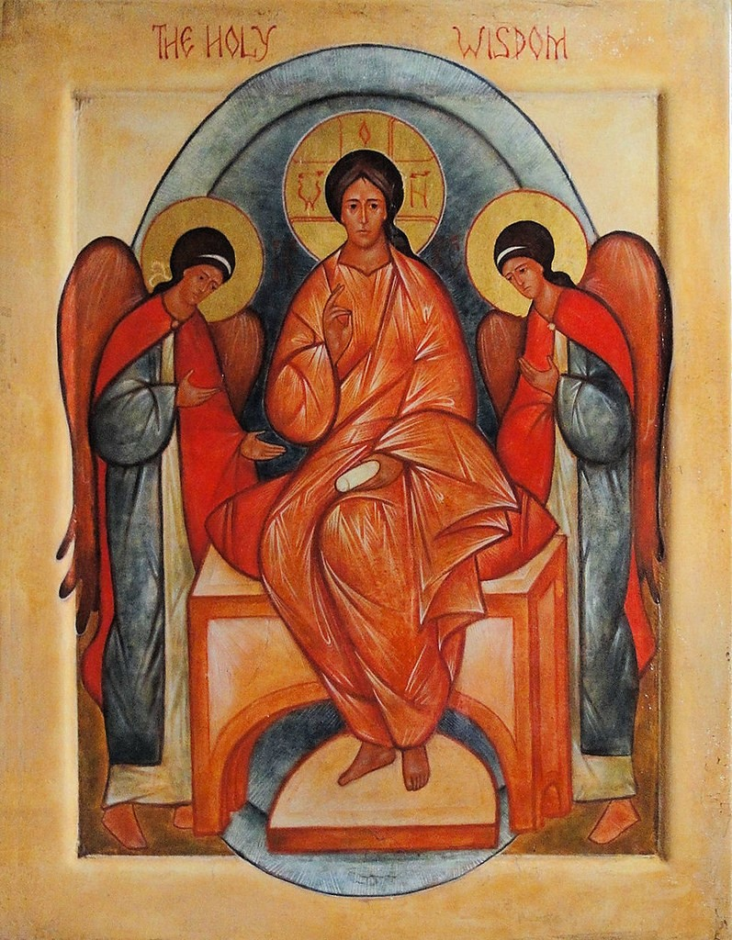
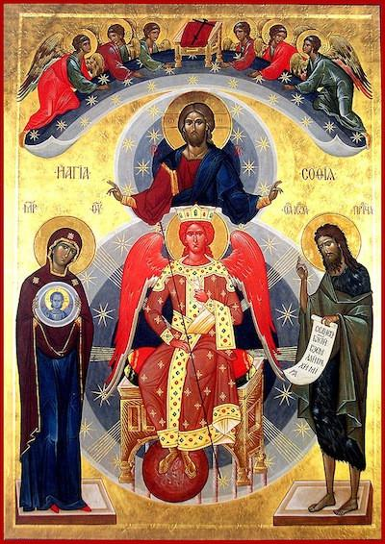

Slide 21
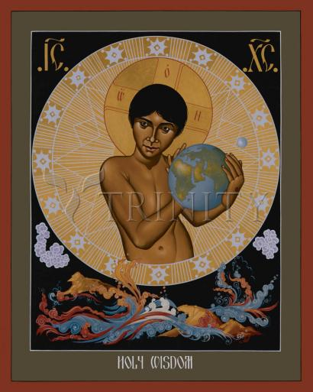

Slide 22
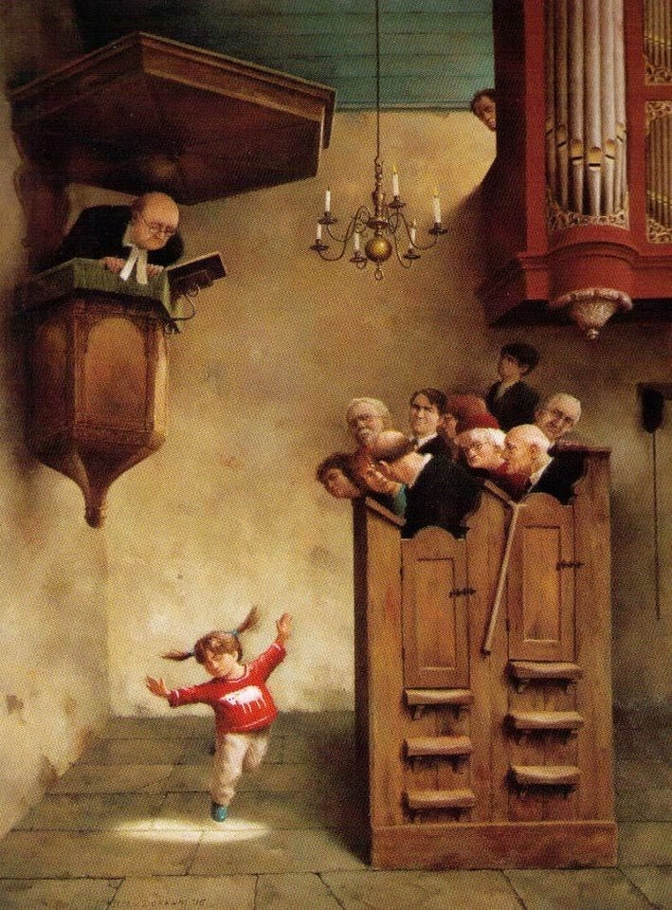

Slide 23
If only we had been there when the earth was born perhaps we would have seen more clearly how precious is our world, how fragile and irreplaceable, perhaps we might have cherished it better and loved it more If only we had been there When the morning stars sang together, and the holy ones shouted for joy
If only we had been there when the vast cathedral of the skies first soared aloft perhaps the music of the stars would have soothed our spirits, and played their harmonies into the lyrics of our lives, perhaps we too might have learned by heart the great psalm of peace If only we had been there When the morning stars sang together, and the holy ones shouted for joy.

Slide 24
If only we had been there when people could meet God face to face, in garden or in whirlwind, perhaps it would have been easier to live with questions, knowing God didn’t want us to stop asking them – perhaps we might have understood they can’t all be answered – at least this side of eternity –
If only we had been there When the morning stars sang together, and the holy ones shouted for joy.
If only we had been there, when the lamb of God was offered before the world’s foundation, perhaps we would have grasped the texture of our universe’s strange fabric, still being woven through with love and sacrifice, perhaps we too might have learned obedience, treading the path of the servant Son, If only we had been there When the morning stars sang together, and the holy ones shouted for joy.

Slide 25
